Slide 1

Basics of Neural Network Programming
Logistic Regression
Gradient descent
deeplearning.ai

Slide 2


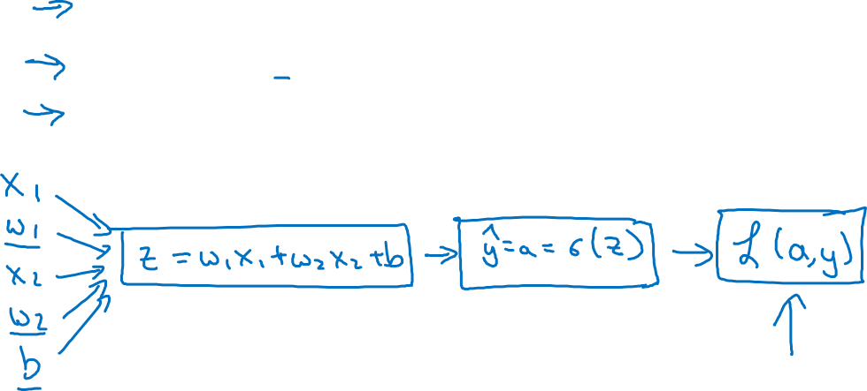
Logistic regression recap
$$z= w^{T}x+b$$
$$\hat{y}=a= σ(z)$$
$$ℒ\left(a,y\right)=−(y\log{(a)+(1−y)\log{(1−a))}}$$

Slide 3
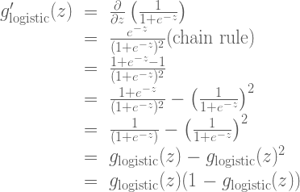





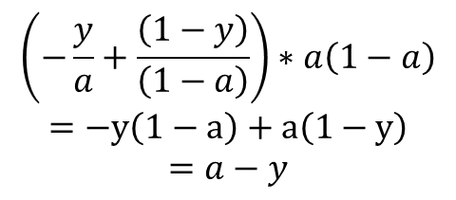

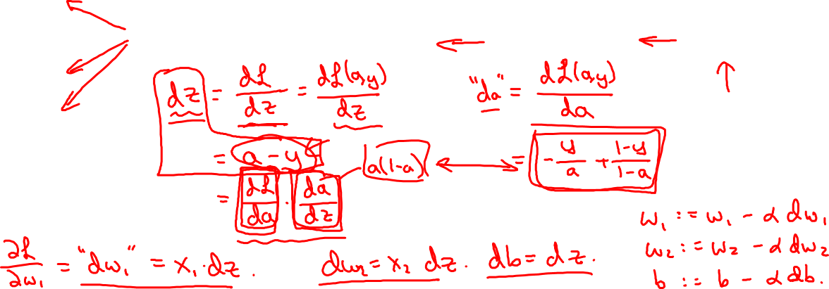

Logistic regression derivatives
$$x_{1}$$
$$w_{1}$$
$$x_{2}$$
$$z= w_{1}x_{1}+w_{2}x_{2}+b$$
$$a= σ(z)$$
$$ℒ(a,y)$$
$$w_{2}$$
b
$$\left(−\frac{y}{a}+\frac{\left(1−y\right)}{\left(1−a\right)}\right)∗a\left(1−a\right)$$
$$=−y\left(1−a\right)+a\left(1−y\right)$$
$$=a−y$$

Slide 4
Basics of Neural Network Programming
Gradient descent
on m examples
deeplearning.ai

Slide 5
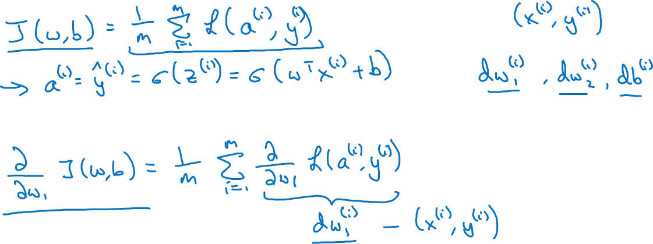
Logistic regression on m examples

Slide 6
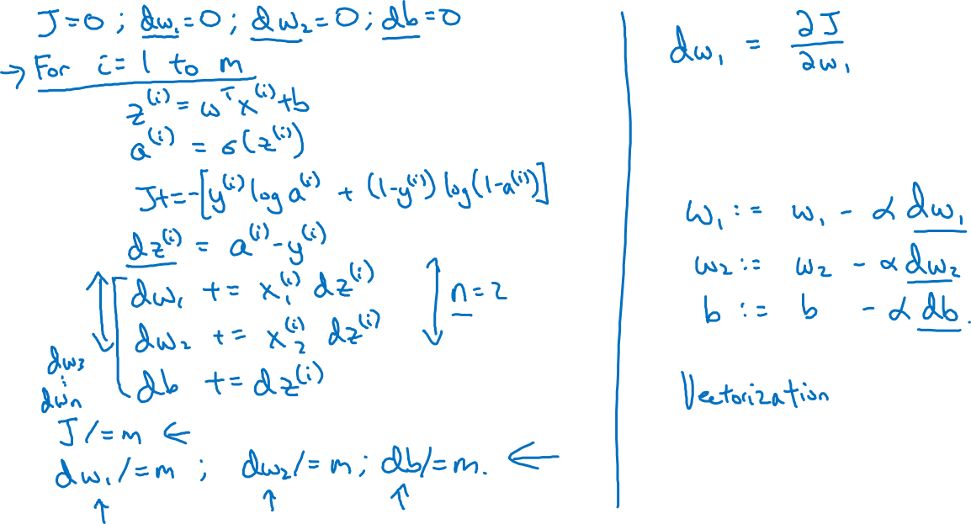
Logistic regression on m examples
Note: dz has superscript (i)
But dw1, dw2, db don’t

